Slide 1
Parent Orientation Summer 2020
Kathy Kotecki, Dean of Students
Aaron Like, Associate Dean of Students

Slide 2
COVID-19 Response
Health & Safety - #1 Priority
MSUB Campus Plans
Academic Plans
Out-of-the-Classroom Plans
MSUB Devoted Webpage
http://www.msubillings.edu/covid19central/
CDC Webpage
https://www.cdc.gov/

Slide 3
ACADEMIC SUCCESS

Slide 4
Classroom Environment & Structure Differences from High School
Size
Meeting times
Format – Lecture vs. discussion
Tests & Grading
Note taking

Slide 5
Last Year’s Freshmen Advice
Go to class!
College is not like high school – it’s harder.
Expect and plan for it.
Figure out how to manage your time.
Seek help / utilize resources.
Connect with your professors.
Get involved on campus!

Slide 6
Support for Academic Success
A&SC 111 – First Year Seminar
Library
Student Support Services
Disability Support Services
Advising & Career Services
Academic Support Center
Developmental Ed Coursework

Slide 7
How is your student placed in math, writing, and reading courses?
Accuplacer Placement Exam
ACT/SAT scores
MUS Writing score
Prior learning credits
Transfer credits
Dual credit courses

Slide 8
Placement Options
College Level
100 and above level courses.
Courses go into GPA calculation and credits earned toward graduation.
Developmental Education Courses
Below 100 level courses.
Will not receive college credit for these courses and grade does not count toward GPA, but DOES count towards financial aid credit tracking

Slide 9
What are Developmental Education Courses?
Courses that “bridge the gap” between your current knowledge and the knowledge you need to be successful in your other courses.
Examples:
M 088, M 098, WRIT 095 (online only), RD 101
Enhanced Courses: Build in Study techniques to match curriculum as part of the Enhancement of the course; 5 days a week vs 3 to ensure additional support
Examples:
WRIT 101E, STAT 141E

Slide 10
Enhancing the Yellowjacket Experience

Slide 12
Housing & Residence Life
Take a Virtual Tour
Visit our Webpage and click “Prospective Students”
Available Pictures
Rooms
Kitchens
Lobbies
Laundry Rooms
Classrooms
Student Lounges

Slide 13
Housing & Residence Life
Housing Live-On Requirement
Students less than 21 years of age with less than 30 credit hours accomplished before the start of the semester, are required to live in university owned residence halls.
Exemptions to the Requirement
Living with Family Member, Online, Marriage, Financial Hardship, Medical, etc.
Visit our webpage for more information!

Slide 14
Housing & Residence Life
Contact Us Today!
Email – housing@msubillings.edu
Phone – 406-657-2333
Hours – Monday-Friday, 8:00 am – 5:00 pm
Location – SUB 225
We are here to help with the housing application, exemption requests, or general housing questions.

Slide 15
Why is Involvement Outside the Classroom so Important?
Connection to the University
Opportunity to build skills, connections
Peer Relationships
Scholarship/Resume Material
Academic Success
Enhances the collegiate experience
Career Exploration/Enhancement
Valuable when applying for competitive programs

Slide 16
Student Organizations
Academic
Campus Media/Literary
Religious
Cultural
Government/Campus Programming
Honorary
Performing & Visual Arts
Special Interest

Slide 17
Student Life
Civic Engagement
Service Saturdays, Student United Way
Night on the Van, Blood Drives
Athletics/Recreation
NCAA Division, On-campus recreation center, intramurals
The Arts
Music, Art, Drama

Slide 18
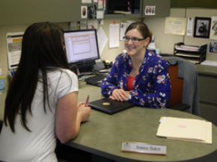
Student Employment
Benefits
Financial Assistance
Skill Development
Networking/Connections
Opportunities
Work-Study
Part-Time
On Campus
Off Campus

Slide 19
Important Campus Information

Slide 20
University Misconduct Process
Students are stewards and representatives of the university and held to Student Code of Conduct
MSUB will hold students accountable for misconduct, along with state, local, federal laws
Education Vs. Enforcement
MSUB is committed to the development of your student if they are committed to themselves
Example: Alcohol Situation Resulting in Insight
Academic integrity is also the responsibility of the student
Cheating, plagiarism, false citations, etc.

Slide 21
Clery Act
Enacted in 1990 after the death of Jeanne Clery (19) in 1986
Assaulted and murdered by another student on campus after room was left unlocked
Previous situations had not been reported to the campus in a timely manner
Requires all federally funded colleges to keep and disclose campus crime information
Annual Campus Security Report due by Oct. 1
Includes major crimes and fire situations
Reports are kept for seven years and published emphatically

Slide 23
Sexual Assault Resources & Awareness
Proactive education for your student:
Developing a campus culture of awareness and prevention
Awareness programming and education and sharing of resources beginning at orientation and continuing throughout the 1st year
Policies and procedures in place, as well as resources if something should happen
24/7 POST certified University Police officers
Title IX Coordinator and Sexual Assault Task Force
Highly qualified and trained student staff
Student Health Services
University Advocate Program
Collaboration with local resources & state Board of Regents policies

Slide 24
Alcohol & Sexual Violence Awareness
Our campus is committed to ensuring students have a positive experience at MSUB. One way we can help is by providing more education about alcohol and sexual assault. Our goal is to show students how alcohol effects the mind and body, how this can impact academic success, and they can reduce the harm associated with alcohol and sexual assault for themselves, their friends, their co-workers, etc.
Alcohol Edu for College is an interactive, online program designed to inform students about how alcohol affects the mind, body, perceptions, and behaviors. It provides students with accurate, non-judgmental information and personalized feedback.
Sexual Assault Prevention for Undergraduates is an interactive, online program created to address sexual assault, relationship violence, and stalking. It’s designed to engage and empower students to create safe, healthy campus environments.
Student Health Services will contact students mid-summer regarding additional information on the programs, instructions, and deadline information. Parents will also be notified about the programs and MSUB’s completion requirements.

Slide 25
FERPA & Parent Notification
Family Education Right to Privacy Act
Affords student rights with respect to educational records, limiting anyone outside of the college to access
Protects “educational records” including grades, transcripts, test scores, ID numbers, financial records, conduct records, and schedules
Does allow for Directory Information including information that is not considered harmful and an invasion of privacy
Legal constraints in place
Supporting student development making transition to adulthood and providing rights and responsibilities
Contacting Professors
Grades

Slide 26
Parent & Family Programs

Slide 27
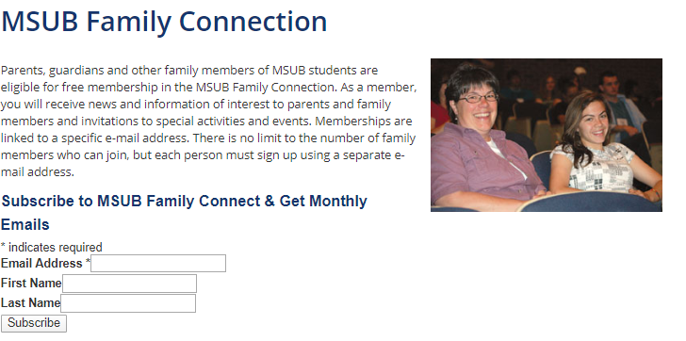
Parent & Family Newsletter

Slide 28
Parent & Family Programs
Kathy Kotecki
Dean of Students
kkotecki@msubillings.edu
Aaron Like
Associate Dean of Students
aaron.like@msubillings.edu

