Slide 1
The Exam Autopsy: Empowering Learners Through Reflective Assessment
Aebersold, A., Jones, J., & Shea, E. (2026, June 24). Montana State University Billings. Initiatives | MSU Billings

Slide 2
Disclosure Statement
This presentation has no financial relationships or conflicts of interest and is intended for educational purposes only.
It examines the use of a post-exam reflective assessment tool (“Exam Autopsy”) to evaluate exam errors, study strategies, and future preparation methods to support student performance and program learning outcomes.
The “Exam Autopsy” model was adapted from a Texas program originally presented at the Indiana University–Purdue University Indianapolis Assessment Conference by Michelle Caetano, Ashley Castleberry, Liz Lafitte, Adam Pate, and Jenny VanAmburgh (2022).

Slide 3
Objectives
01 | Introduction of the Exam Autopsy
02 | Implementation Among Disciplines & Early Findings
03 | Break-Out Groups for Discussion
04 | Sharing of Possible Iterations & Invitation for Future Collaboration
05 | Key Takeaways & Questions

Slide 4
What is the Exam Autopsy?
A metacognitive tool that engages students in a post-exam assessment.
  https://acrobat.adobe.com/id/urn:aaid:sc:us:827826b1-3be1-4863-b9c9-d07fffe9c40b
  What valuable insights can be gained from the Exam Autopsy process?

Slide 5

Identification of Common Error Types
Analyzes the most frequent error types made by students
  Test Taking Errors
  Test Anxiety
  Concept Errors
  Careless Errors
  Proper Instruction

Slide 6

Evaluation of Study Strategies
Assesses which study methods were most commonly used and their effectiveness
  Re-reading notes
  Recording lectures
  Practice problems
  Time management
  Study groups
This Photo by Unknown Author is licensed under CC BY

Slide 7

Implementation Across Disciplines
Programs & Courses across the Campus
  Radiologic Technology
  Diagnostic Medical Sonography
  Medical Coding
  Nursing
  Mathematics
  Reading/Writing
  Communications
  History, and more…
This Photo by Unknown Author is licensed under CC BY-NC

Slide 8
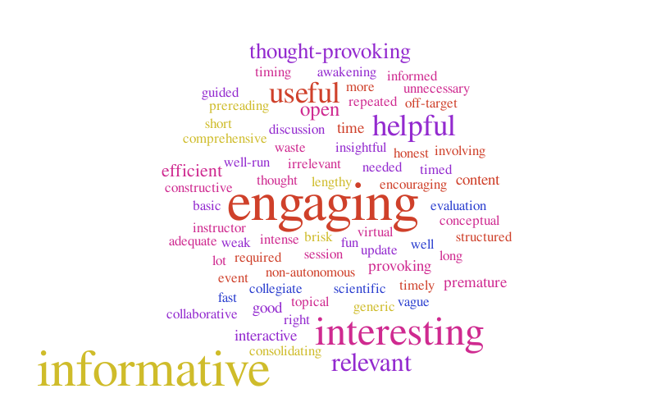
From Concept to Practice: Implementing the Exam Autopsy
Radiologic Technology
  Jenna Jones
Reading
  Erica Shea
This Photo by Unknown Author is licensed under CC BY-NC-ND

Slide 9
Early Findings
Radiologic Technology Program
  Mean exam scores higher for students using the exam autopsy
  National Registry exam pass rates increased from 78% in 2022 to 100% in 2023 following implementation of the tool.
Spring 2025
  Introduction of Exam Autopsy at Center for Teaching and Learning (CTL) Faculty Workshop
  Summer 2025
    Launch Pilot Study with additional courses/programs

Slide 10

Early Findings Cont...
Summer 2025 Pilot
  Every student cited they would use the Exam Autopsy again
  Error Types (423 total):
    Student preparation errors (29%)
    Test taking errors (27%)
    Application errors (8%)
    Misread errors (10%)
    Careless errors (14%)
    * Students are struggling more with study habits and test taking strategies than actual course content!

Slide 11
Error Types for History Course in 2025 Summer Pilot

Slide 12
Early Findings Cont.…
Sample Cohort from Radiologic Technology Summer Pilot
  Fall 2025
    Evidence of decrease in total # of missed questions over three exams
    Evidence of continued improvements with less application and test-taking errors, misread errors, and careless errors
  Spring 2026
    Significant evidence of improvements specifically in total # of missed questions, misread errors, and careless errors
    Mean exam scores higher on a class average
      ** Scoring 80% or higher in all categories on Final Mock Board Registry!
      **100% First-time Pass Rate on 2026 ARRT Board Registry (as of 6/2026)!

Slide 13
Error Types for Rad Tech Pilot Cohort

Slide 14
Break-out Groups & Sharing of Possible Iterations
Please join us for some small group discussions here: Exam Autopsy Small Group Notes - Google Docs
What variations of the Exam Autopsy are being used at your institution?
If you are gathering data, how is it being collected and used?
What adaptations of the Exam Autopsy can you imagine for papers or projects?
What collaborations between the Exam Autopsy and your CTL or other student support departments do you foresee working?

Slide 15

Invitation for Future Collaboration
Together, we can transform assessment into a tool for deeper learning and student success. Interested in:
  Questions & Conference Reflection?
  Comments & Feedback?
  Collaborative Brainstorming?
  Future Implementation of Ideas?
  Networking?
  Connect with us here: Exam Autopsy Collaboration
This Photo by Unknown Author is licensed under CC BY-NC

Slide 16
Key Takeaways
Student
Promote student reflection for improved exam performance and empower students to build successful study habits.
Decrease test-anxiety and test-taking errors.
Instructor
Examine error patterns and relate data to learning outcomes for students, instructors, and programs.
Enhance curriculum and instructional practices to promote effective study habits and improved learning outcomes.
Program
Increase Board Exam Pass Rates and Program Effectiveness.
Maintain Accreditation Standards and Compliance.

Slide 17

This Photo by Unknown Author is licensed under CC BY-NC

Slide 18
References (1 of 2)
Bercher, D. A. (2012). Self-monitoring tools and student academic success: When perception matches reality. Journal of College Science Teaching, 41 (5), 26-32.
Caetano, M., Castleberry, A., Lafitte, L., Pate, A., & VanAmburgh, J. (2022). Exam Autopsy. [Adopted from a Texas program presented at the IUPUI Assessment Conference]
Gerdes M. Teaching-Learning Strategy for Promoting Student Success: Asynchronous Post-Exam Reflections. Nursing Science Quarterly. 2018;31(4):335-339. doi:10.1177/0894318418792876
Iwamoto, D. H., Hargis, J., Bordner, R., & Chandler, P. (2017). Self-regulated learning as a critical attribute for successful teaching and learning. International Journal for the Scholarship of Teaching and Learning, 11 (2), 1-10.
Owen, Leanne R. (2019) "The Exam Autopsy: An Integrated Post-Exam Assessment Model," International Journal for the Scholarship of Teaching and Learning: Vol. 13: No. 1, Article 4. Available at: https://doi.org/10.20429/ijsotl.2019.130104

Slide 19
References (2 of 2)
Shemberger, Melony, "Post-exam Reviews: Turning Wrong Answers Into Learning Moments" (2020). Pedagogicon Conference Proceedings. 8. Available at: https://encompass.eku.edu/pedagogicon/2019/guidinggrading/8&nbsp

