Slide 1
PCI COMPLIANCE
Compliance is mandatory for all organizations that accept credit cards.

Slide 2
January 10, 2013
Texas Southern University's radio station KTSU gave a volunteer position to a person with a criminal history of credit card fraud. The volunteer was later arrested for allegedly using the radio station's donation drive to steal credit card information. The dishonest volunteer faces up to 300 counts of credit card fraud for attempting to use the information on donor pledge sheets.

Slide 3
TARGET CREDIT CARD FRAUD
70 million accounts compromised.
“I don’t see how TARGET is getting out of this for under a billion, over time,” he said, adding, “$150 million in a quarter seems almost like a bargain.”
The company also said it expected earnings to drop to 78 cents a share from its earlier projections of 85 cents to $1 a share, reflecting more cautious consumer spending.
$3.6 billion in potential fines.

Slide 4
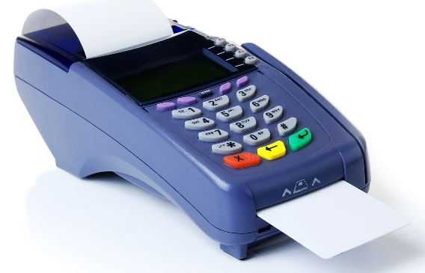
Financial Exposures to a Breach
Forensic Examination – cost of consultant fees
Notification of Third Parties – cost of mailing a formal notification to customers
Call Centers – cost of staffing and supplies to handle incoming calls
Credit or Identity Monitoring – approx. $30/account
Public Relations –
Loss of reputation with customers, suppliers, partners and loss of future revenue
6) Legal Defense - Possible civil litigation from breached customers -
7) Regulatory Proceedings, Fines and Penalties –
$50-$100 fine/account compromised
8) Comprehensive Written Information Security Program – cost of consultant fees
9) Loss of credit card privileges – approx. 70% of MSUB students use credit cards
to pay some or all of their tuition

Slide 5
DO and DON’T
Do not accept CHD from an email or FAX.
Do not enter into any computer CHD, all documents leave hidden files when deleted.
Do not enter CHD into a third party software system for a customer.
Under certain circumstances you may take credit cards over the phone.
Under certain circumstances you may process CHD received via postal or express mail services.
Secure your CHD storage areas when not attended.
Do not store CHD long term, only Business Services will store for long term any paper media related to CHD
Secure devices that capture and transmit CHD, POS and swipe card systems
Inspect these devices for tampering or substitution
Report any suspected tampering or fraud to the CIO, Business Services Director or the Vice Chancellor of Administration
Materials must be secured in safes, file cabinets, locked rooms or storage areas with limited access to those personnel
All employees with access to CHD must be trained annually.

Slide 6
PCI RELATED MATERIALS
http://www.msubillings.edu/boffice/Policy%20&%20Procedures.htm
https://www.pcisecuritystandards.org/pdfs/pcissc_overview.pdf
http://usa.visa.com/download/merchants/alert-pos-terminal-tampering-020311.pdf
http://www.globalpaymentsinc.com/USA/customerSupport/fraud.html
https://www.pcisecuritystandards.org/pdfs/pci_fs_data_storage.pdf

