Slide 1
Using the Online Library
-a useful guide to informing yourself and others (with credible sources!)

Slide 2
Who cares?
The answer: your professor, your audience, and you!
We occupy a period in which misinformation runs rampant throughout the sources we rely upon to stay educated.
Anyone can put information online, whether it is checked (peer-reviewed) or not. This is why the online library, and all of the sources it encompasses, are so vital to informing yourself. Your next paper or project can be backed by facts, statistics, and empirical evidence. And because of that, you can end the day knowing that you shared useful and reliable information with your audience.

Slide 3
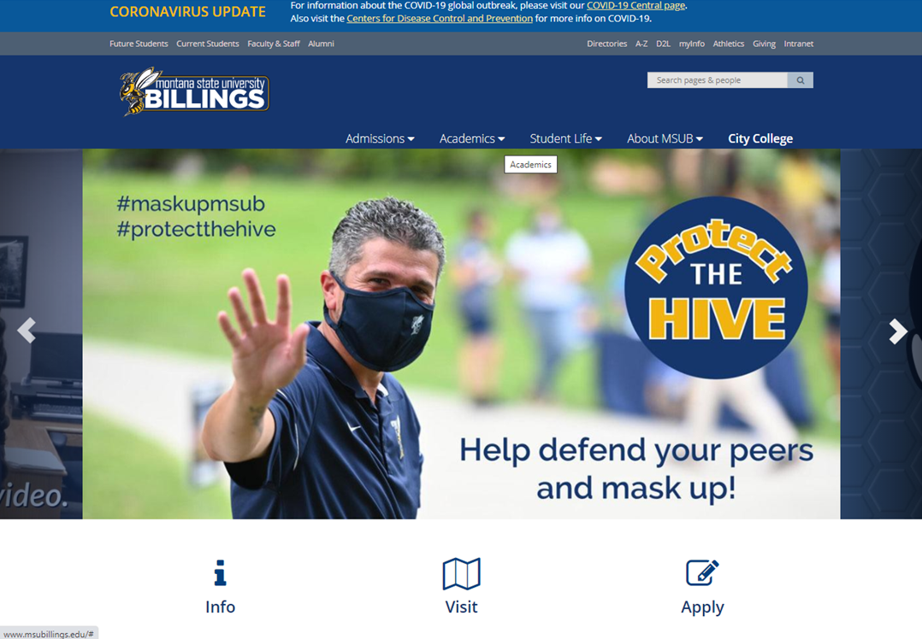
Access the MSUB Homepage
Found at:
http://www.msubillings.edu/

Slide 4
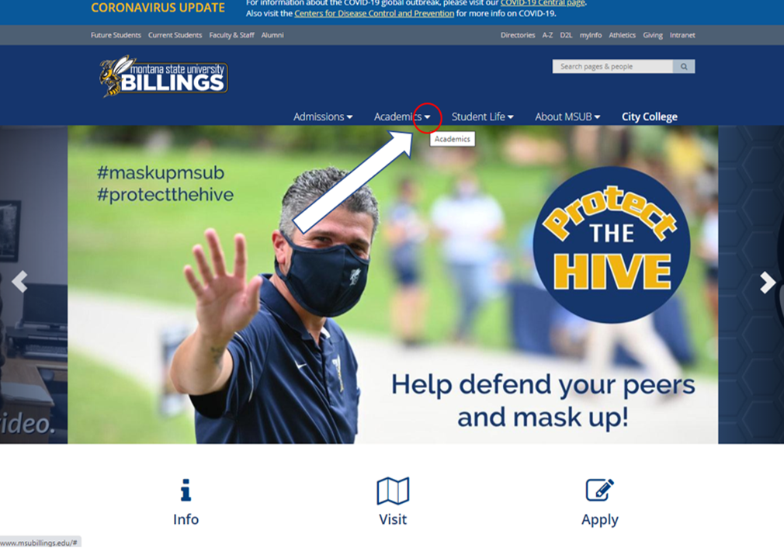
Find the “Academics” tab
Click the drop-down arrow!

Slide 5
Find the “Library” button
Click it!

Slide 6
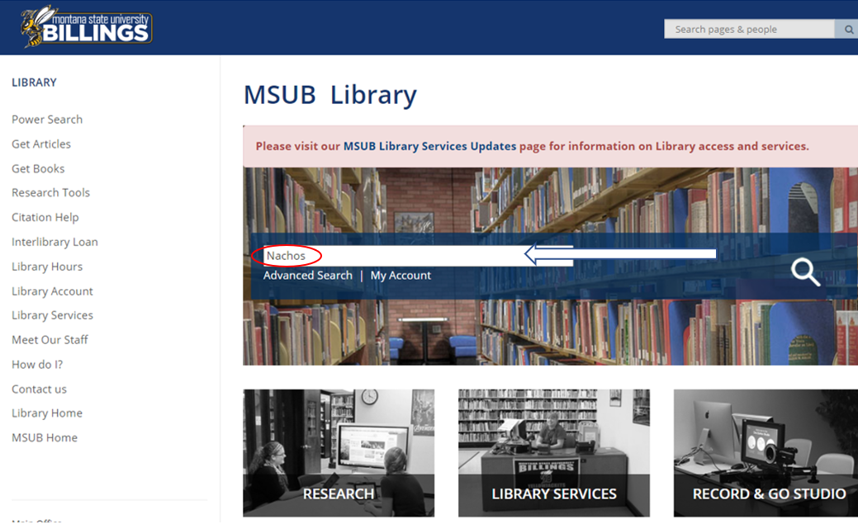
Enter your search term
Enter your search term into the power search bar

Slide 7
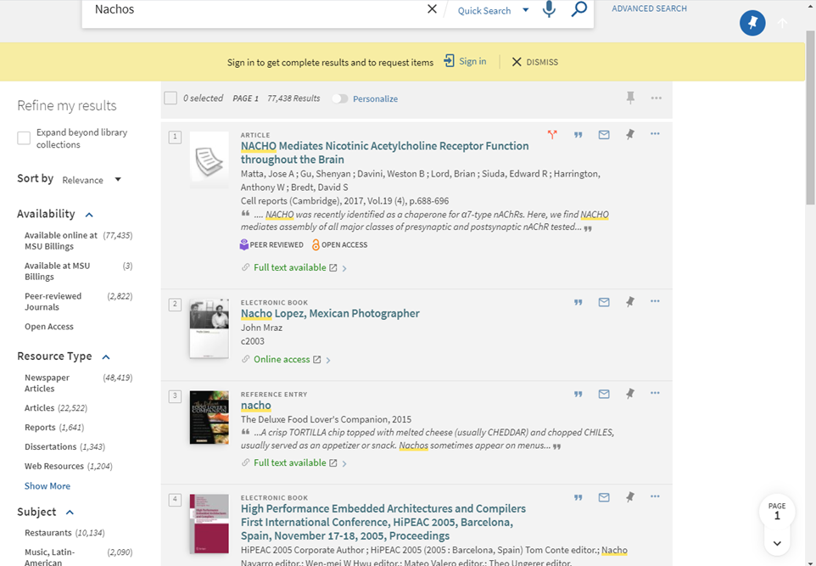
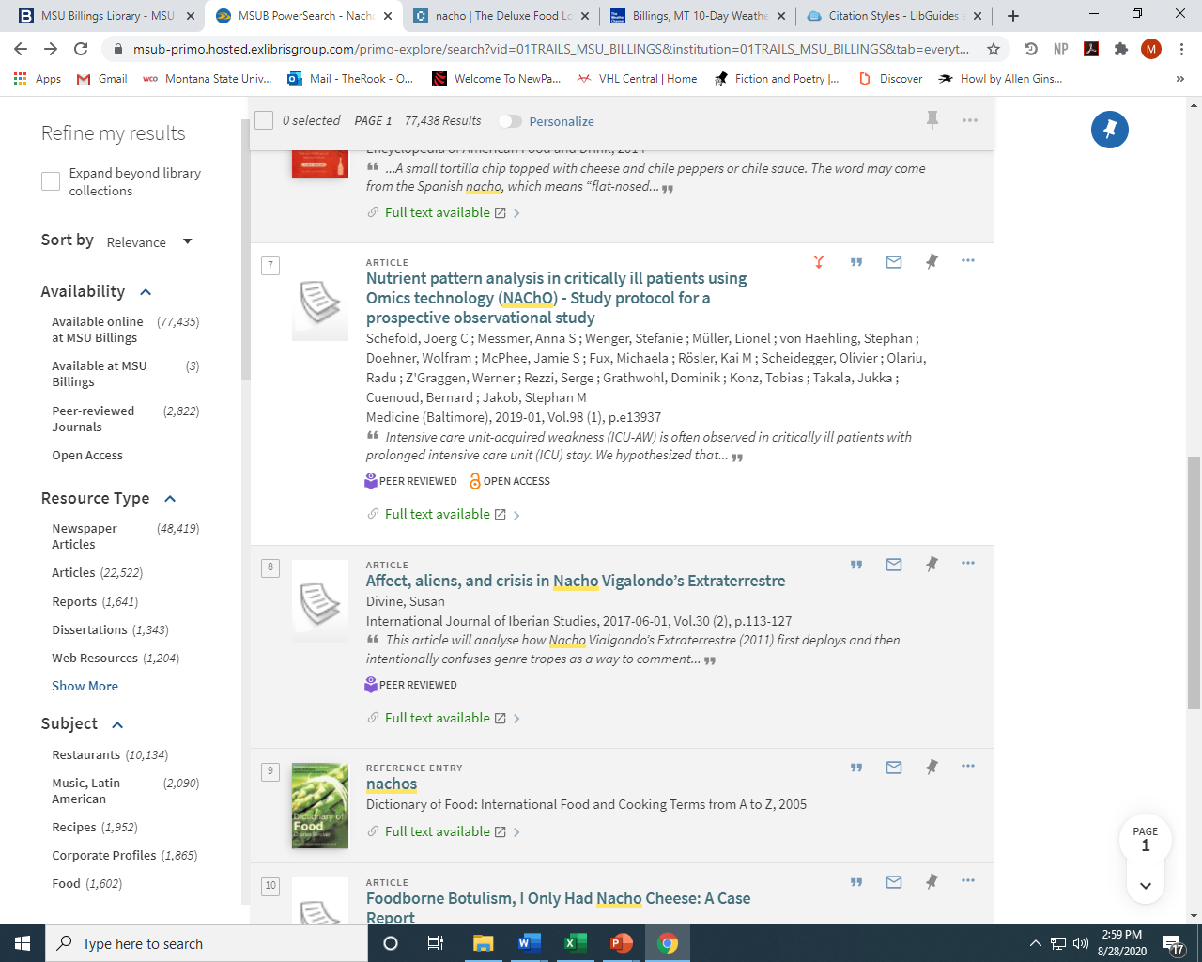
Consider your results

Slide 8
Refine your search
Narrow your search results by:
-relevance
-date
-author
-title
-availability
-resource type (newspaper article, articles, reports, dissertation, web resources, etc)

Slide 9
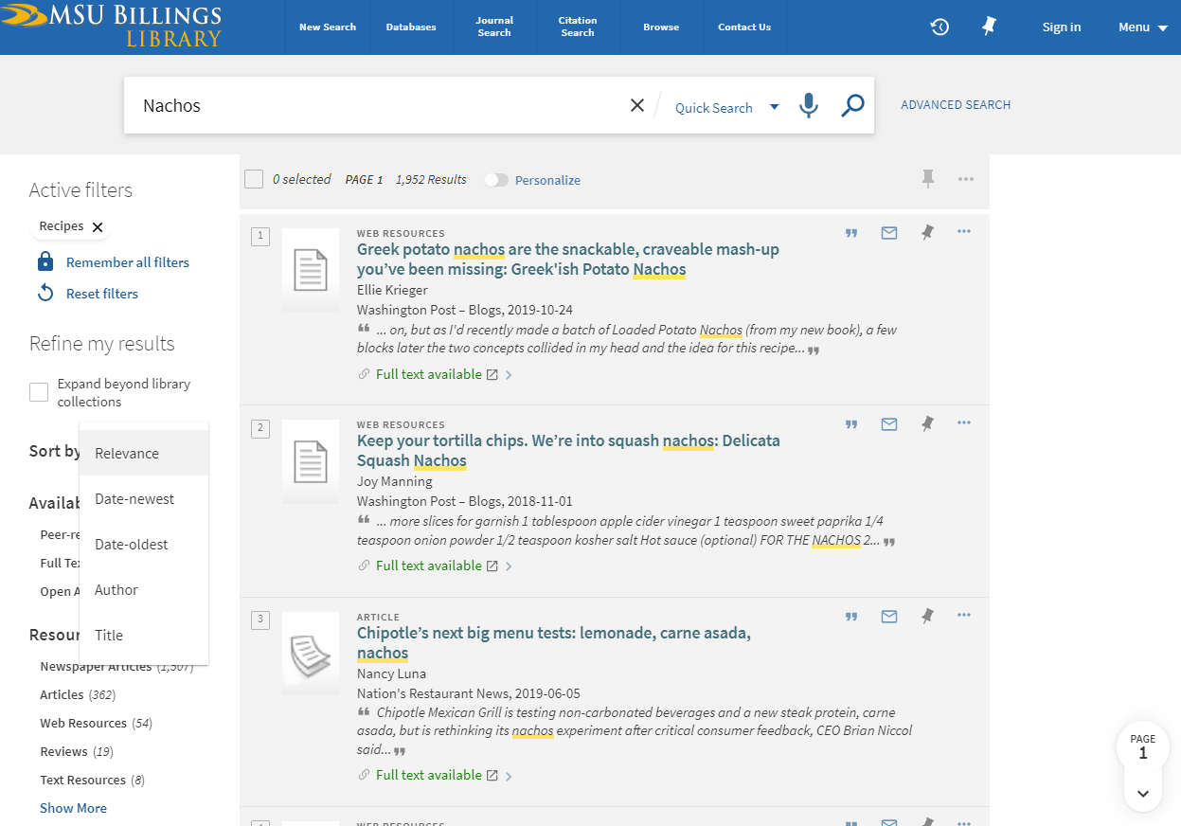
Refine your search
Find the “sort by” drop down box

Slide 10
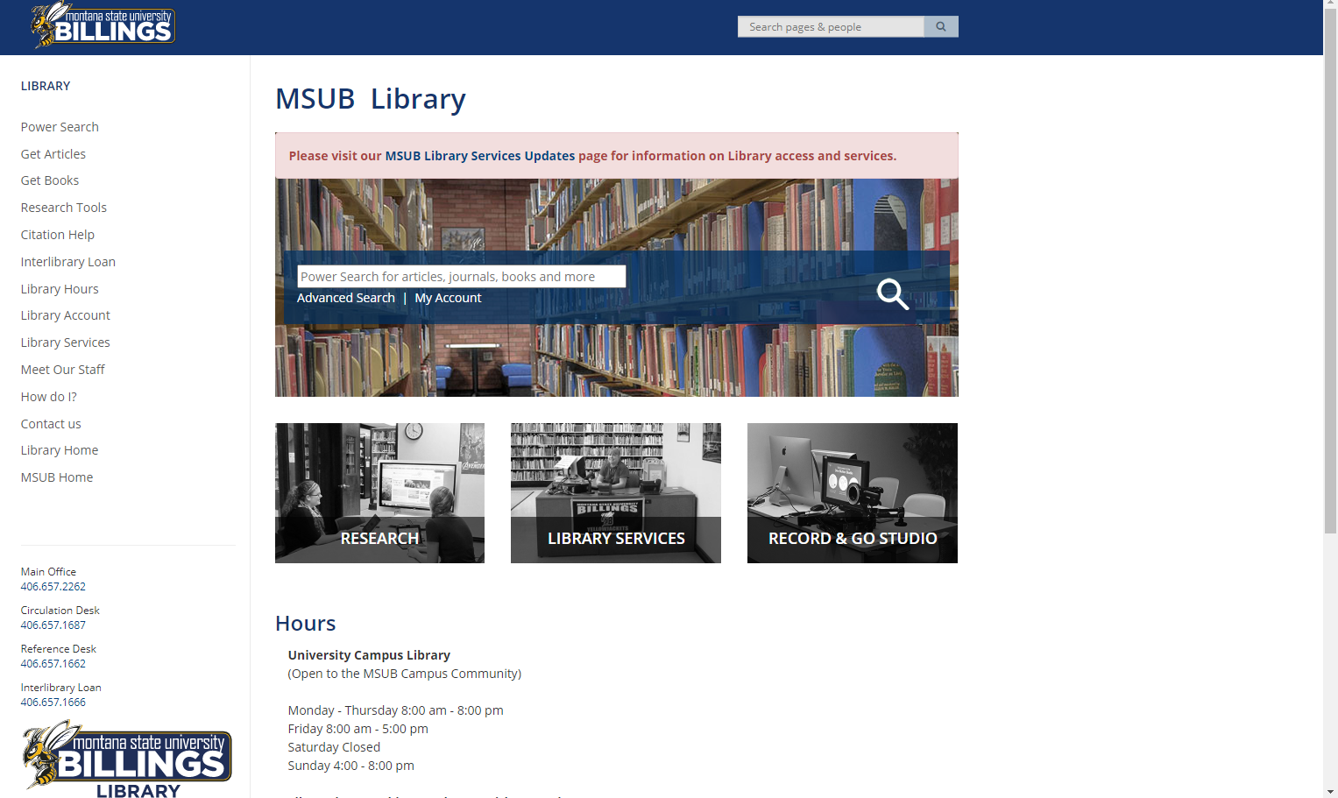
Databases
Return to the MSUB library page
Find the “Get Articles” link

Slide 11
Databases
You can find databases by subject, alphabetically, or you can check out a shortlist of databases most commonly used by MSUB faculty and students

Slide 13
Databases by subject
Sometimes, searching by subject can be more useful and efficient than searching via ‘Power Search.’
Doing so will provide a list of databases that are more relevant to your field, or the class you are working in.

Slide 14
The Big 8

Slide 15
Academic OneFile
Academic OneFile is a source for peer-reviewed, full-text articles from the world's leading journals and reference sources. With extensive coverage of the physical sciences, technology, medicine, social sciences, the arts, theology, literature and other subjects, Academic OneFile is both authoritative and comprehensive. With millions of articles available in both PDF and HTML full-text with no restrictions, including full-text coverage of the New York Times back to 1995. Updated daily.

Slide 16
Academic Search Complete
Comprehensive scholarly, multi-disciplinary full-text database.

Slide 17
Business Insights: Essentials
Combines all of the content formerly found in Business & Company Resource Center with a new interface designed around the research goals and workflows of your diverse business research community. Easily find information on companies, industries and more in the context of timely news, statistical data, and in-depth reports.

Slide 18
Business Source Complete
Scholarly business database, providing comprehensive collection of bibliographic and full text content. Contains indexing and abstracts for the most important scholarly business journals back as far as 1886. In addition, searchable cited references are provided for more than 1,300 journals.

Slide 19
JSTOR
Scholarly business database, providing comprehensive collection of bibliographic and full text content. Contains indexing and abstracts for the most important scholarly business journals back as far as 1886. In addition, searchable cited references are provided for more than 1,300 journals.

Slide 20
Nexis UNI
Nexis Uni features more than 15,000 news, business, and legal sources from LexisNexis- including U.S. Supreme Court decisions dating back to 1790.

Slide 21
Project MUSE
100% full-text, user-friendly online access to high quality humanities, arts, and social sciences journals from scholarly publishers.

Slide 22
Wallstreet Journal
Or, ProQuest, offers comprehensive coverage from the world's leading financial newspaper. 1884-present, full-text.

