Slide 1
Student Health/Safety and You

Slide 2
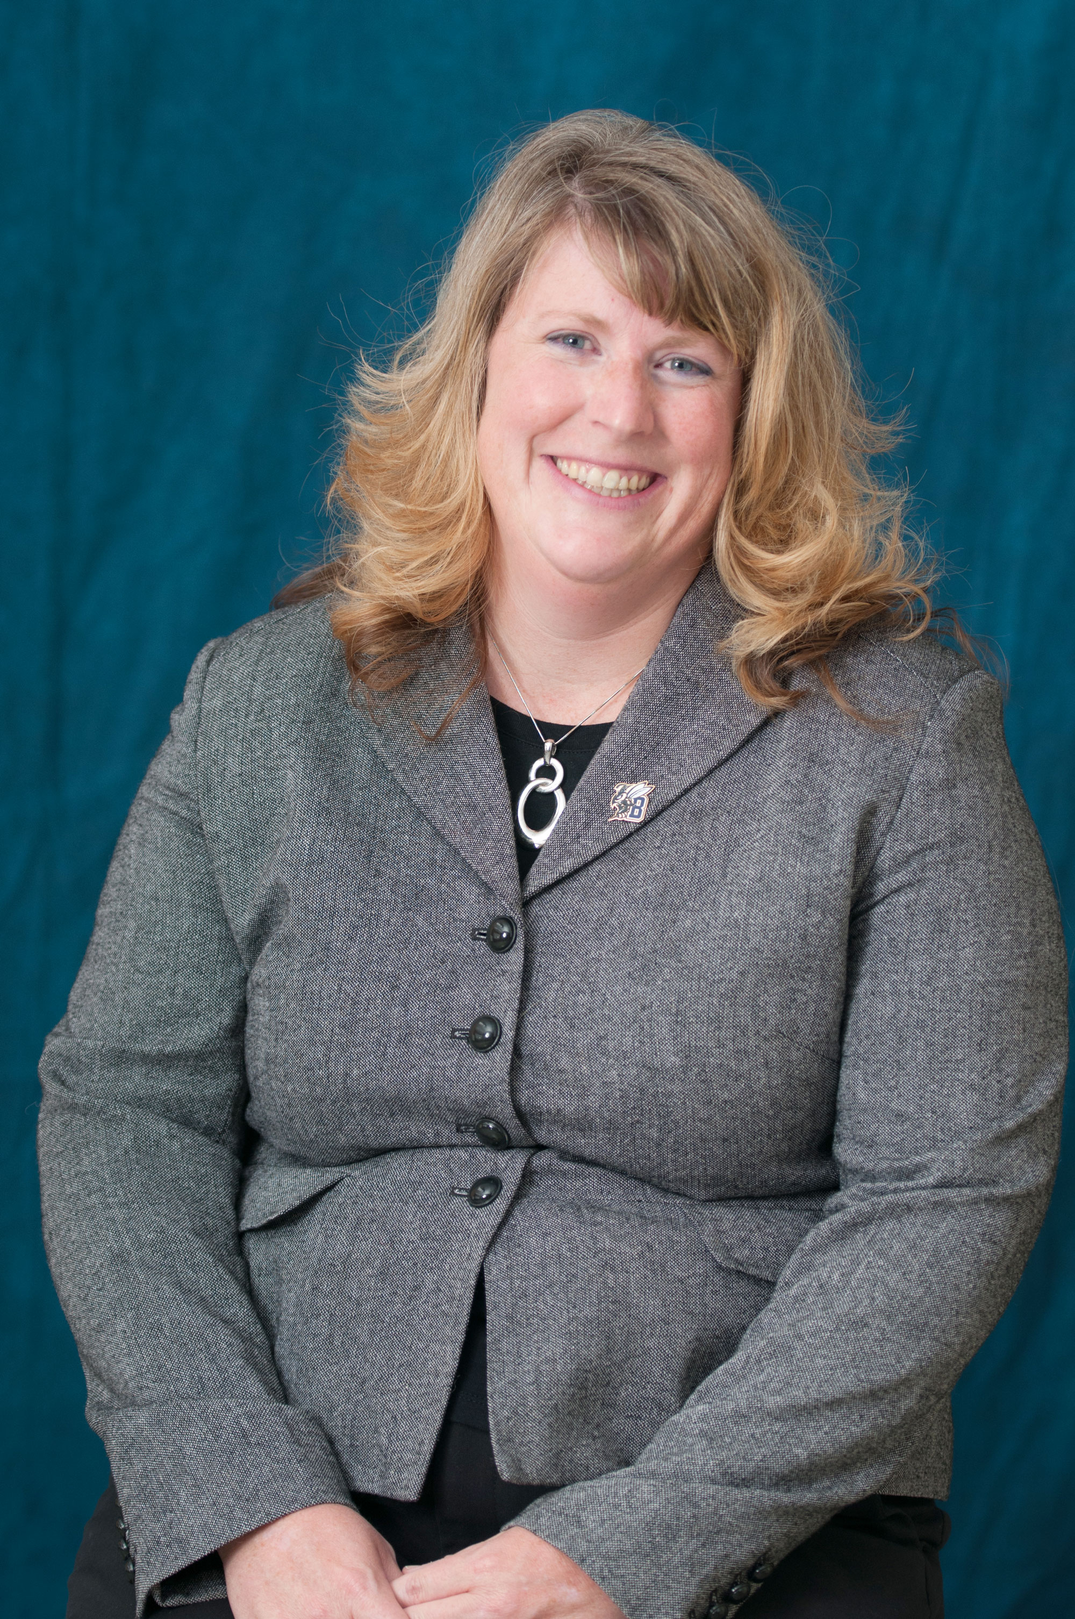
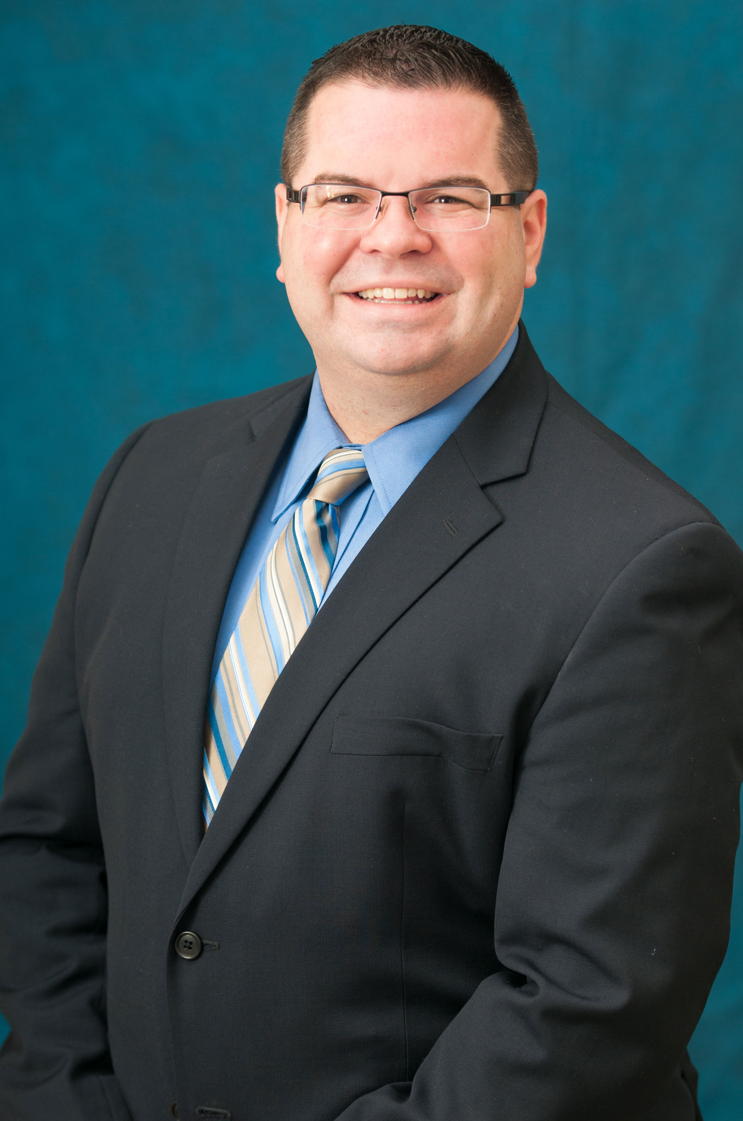
Introductions and Background
Kathy Kotecki, Interim Dean of Students
20 years of higher education experience
MSUB institutional history
Housing & Residential Life
Student Conduct & Conflict Resolution
Mental Health Background
Crisis Management Skills
Title IX Investigator
Jeff Rosenberry, Interim Associate Dean of Students
10 years of higher education experience
Housing & Residential Life
Student Conduct & Conflict Resolution
Mental Health Background
QPR (Question, Persuade, Refer) Certified
Crisis Management Skills
Title IX Investigator

Slide 3
Why Are We Doing This?
Classroom behavior is important and we can support accountability
Mental health issues are on the rise amongst college students
The university has systems in place to support you and students:
Conduct Review Team
Student Consultation Team
We want to provide a “one stop service” for your questions & thoughts
Intervention starts with you!
We can’t support our students unless you say something when you see something

Slide 4
See Something, Say Something
Most people don’t Step Up and Say Something
Most problems happen in group settings like the classroom
Faculty/Staff are usually in a better position to do something
You may be in a situation in which you can help in the future
There may be more then the situation you are dealing with and we help to bring all the pieces of the puzzle together

Slide 5
What To Report & How?
Violations of the Student Conduct Code
www.msubillings.edu/seesomething
Document what you see and let us take it from there…
We are not asking you patrol or make decisions on the outcome for that student

Slide 6
Don’t Make Reporting Complex
If you are in a hurry or don’t remember which report to use, just report on either and we will do the rest.

Slide 8
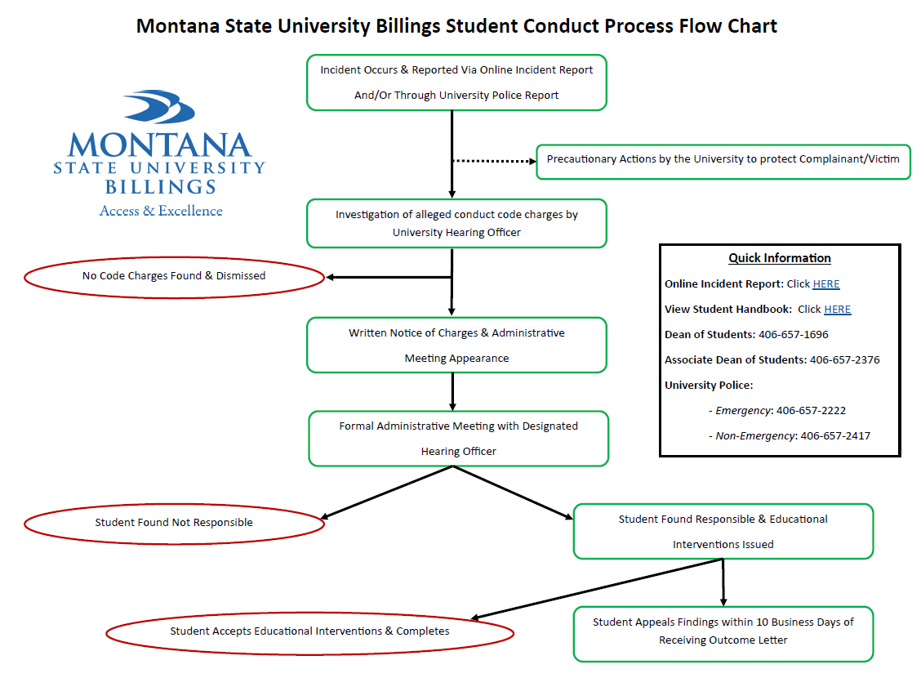
Flow Chart

Slide 9
What To Report & How?
Student Consultation Team
www.msubillings.edu/sct
Depression, disruptions, aggression, grieving, under the influence, and more.
Complete Distressed Student Guide and Quick Links

Slide 13
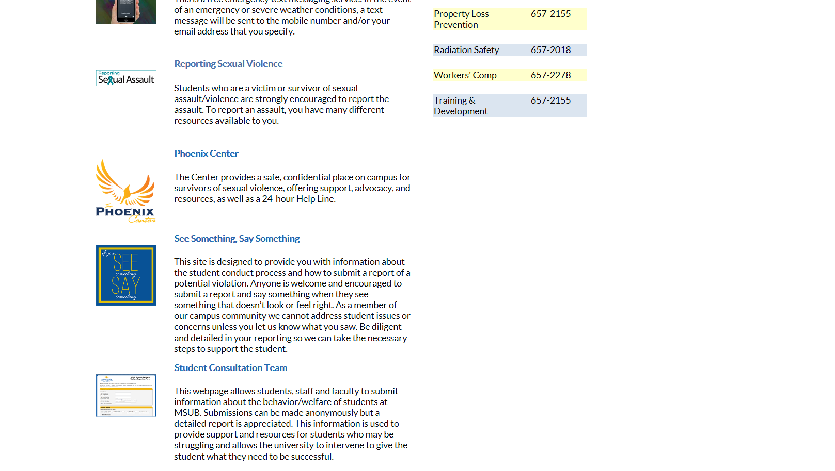

Slide 14
Keep Yourself & Your Students Safe If concern is immediate, Contact University Police: 406-657-2222 - Deescalate the situation as safely as you can - Ensure the safety of everyone present - Take note of important reporting information

Slide 15
Resources & Important Information
Student Conduct Code Violation (See Something, Say Something): msubillings.edu/seesomething
Click on “Report an Incident”
Student Behavior & Welfare Concerns: msubillings.edu/sct
Click on “Report A Student Concern”
Distressed Student Guide and Quick Reference Links
Student Health Services: msubillings.edu/studenthealth
Medical/Counseling/Wellness Services & More
Don’t Cancel That Class Program
Housing & Residential Life: msubillings.edu/reslife
Trained front line staff
University Police
Non Emergency: 406-657-2147
Emergency: 406-657-2222
Kathy Kotecki, Interim Dean of Students
Student Union Building, 223
406-657-1619
kkotecki@msubillings.edu
Jeff Rosenberry, Interim Assoc. Dean of Students
Student Union Building, 225
406-657-2376
jrosenberry@msubillings.edu
Dr. Joe Oravecz, Vice Chancellor for Student Affairs
McMullen Hall
406-657-2307
Joe.Oravecz@msubillings.edu

Slide 16
Webinar: Managing Personality Disorders In The Classroom: Essential Tools, Strategies and Resources
Wednesday, September 9, 2015
11:00 am – 12:30 pm
Sponsored by Academic Affairs and Student Affairs
**Watch for more information coming soon through Admin Gen. –
faculty and staff will have the ability to access the webinar from your desk!

Slide 17
Questions/Concerns/Thoughts

