Slide 1
E market
Notes:
eMarket replaced Property & Supply
Most economical way to purchase supplies.
Anyone can get signed up.
Offices with out Pcards can be set up as shoppers and issue the basket to a buyer in the AP office.

Slide 2
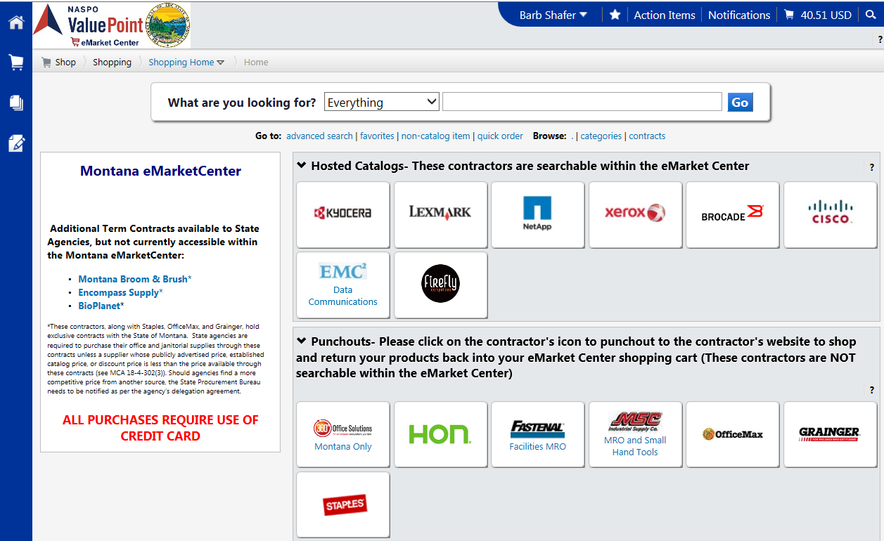
Notes:
Multiple Vendors available on emarket

Slide 3
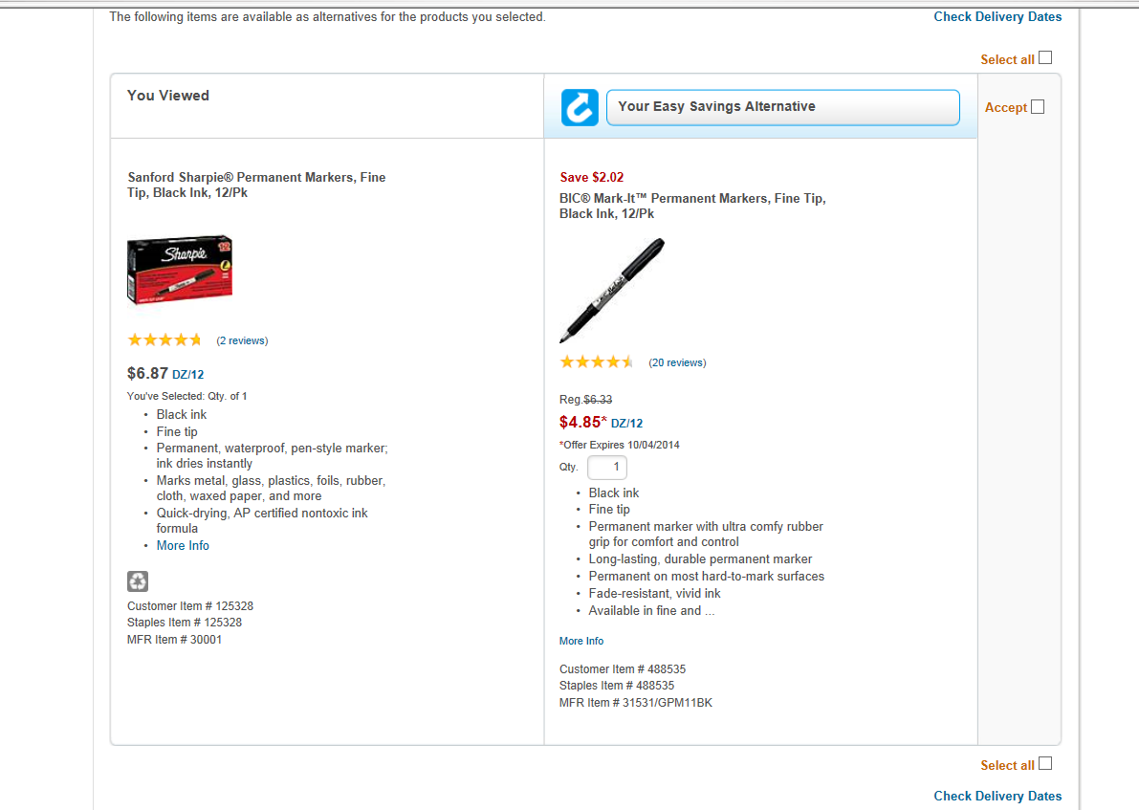
Notes:
Saving alternatives are provided for items available

Slide 4
Staples
Office Max
360 Office Solutions
Notes:
Save more on emarket
These are quotes for the same toner in all three emarket stores. As you can see it pays to check within them for the best prices.
The University Recommend only brand toner in Printers. Remanufactured toner voids warranty.

Slide 5
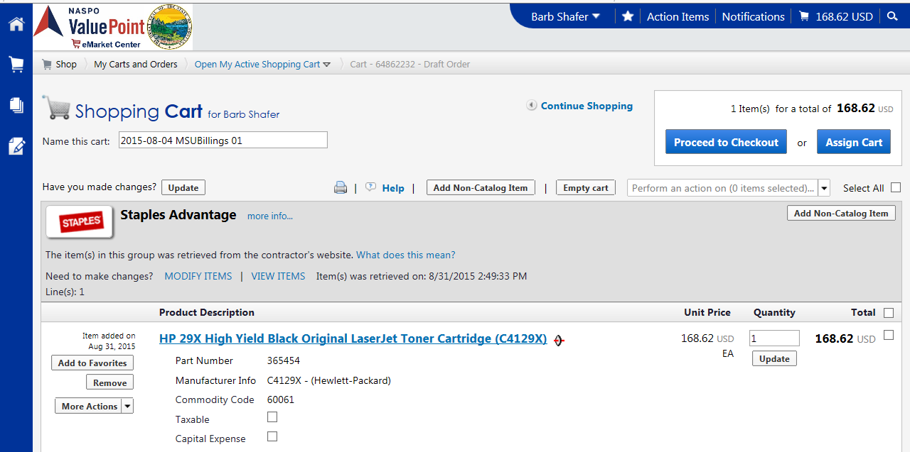
Notes:
After review of the cart choose either Assign Cart or Proceed to Checkout
These next steps will show both options

Slide 6
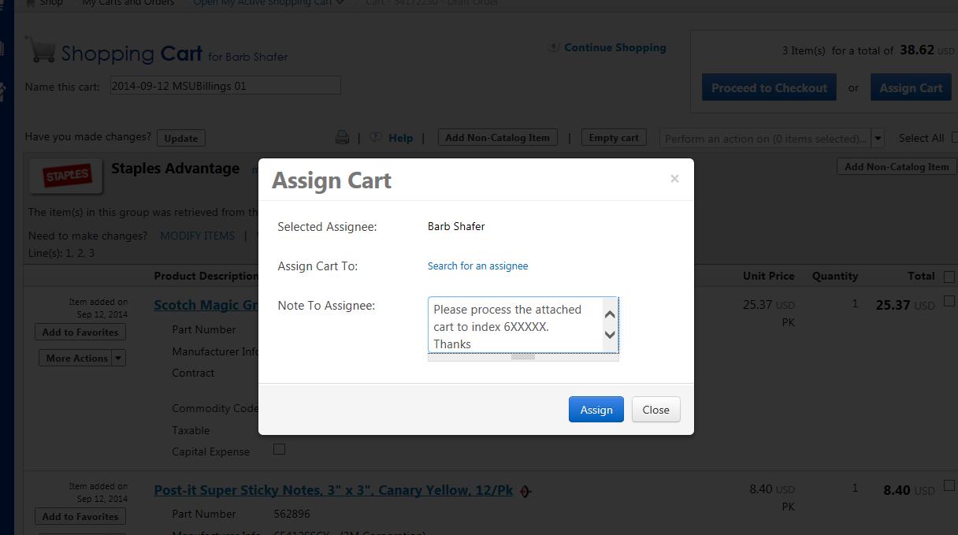
Notes:
Assigning a Cart to AP is easy. Search for the AP clerk or Purchasing
Include a note to the assignee.
Email notifications are sent to both individuals.
Let us know if you want to get set up or need training.

Slide 7
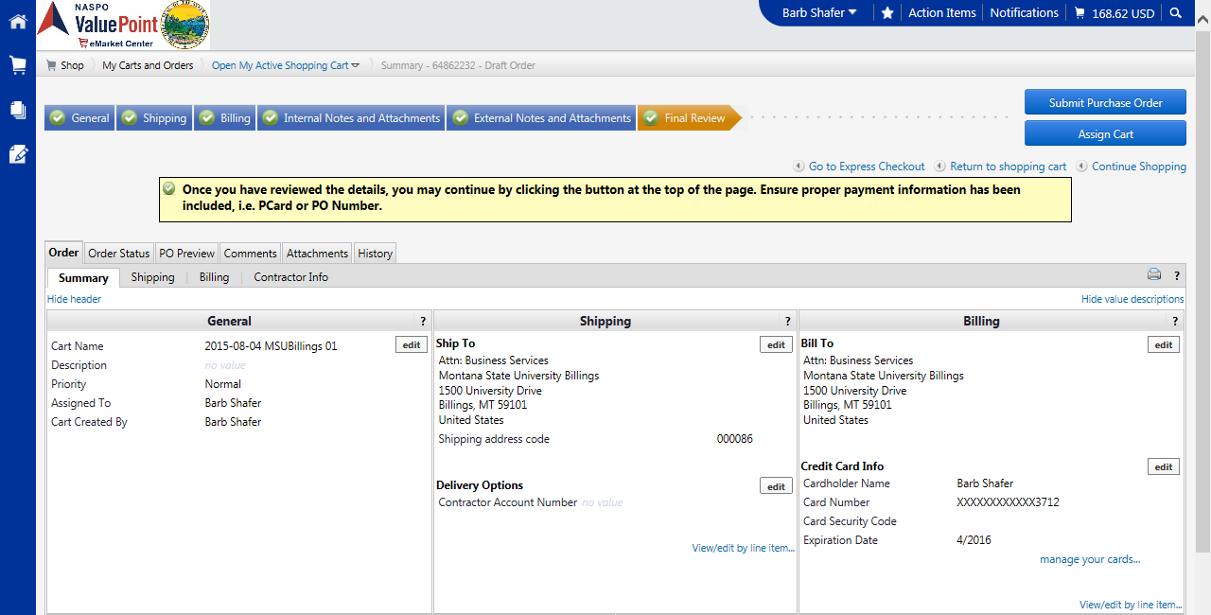
Notes:
Click on each tab to review the sections separately.
Billing requires you to add in a Pcard. If you do not have one issue the cart to Purc

Slide 8
Questions
Thank You
Barb Shafer
657-1710
Suggested Future training items
Please email bshafer@msubillings.edu
Notes:
Be sure to let us know what you would like to see being trained on for future trainings.
Let us know if you would like more discussion or training on a personal level. We are happy to assist in making this easier on all ends.
Helping you perform your job is also helping ourselves!

