Slide 1
English Folk Music

Slide 2
IDEAS AND CONCEPTION

Slide 3
Folk Music
Folk music recounts or reveals the history of a culture in a musical way.
National, linguistic and cultural factors distinguish groups of folk music from one another.
(Nettl et al, 2012)

Slide 4
English Folk Music
National Influence
The content of English Folk Music is highly influenced by it history. Folk songs were written about very iconic British topics such as King Arthur, Robin Hood and the Navy.
Linguistic Influence
The people that came to inhabit the British Isles were Indo-European speaking people and made music in the language that would become English.
Cultural Influence
The style of English folk music is undeniable Western as England is deep within the area that is highly associated with Western style music.
(Nettl et al, 2012)

Slide 5
English Folk Music
Arose concurrently with the arrival of English people in Britain in 400 CE.
What is now recognized as traditional English folk is the music developed by the lower class British citizens during a time when wealth disparity created distinct classes.
(Folk music of England, 2012)

Slide 6
Types and Uses of English Folk Music
Ballads
Versatile songs for telling many types of narratives.
Carols
Used in celebration of events such as festivals, holidays, etc.
Example: The Holly and the Ivy http://www.youtube.com/watch?v=57l6dSbVppM
Children’s Songs
Lullabies, nursery rhymes, etc. These song were passed down, mostly orally, to children as past times, learning mechanisms and for many other purposes.
Example: Mother Gooses’ Melody
(Folk music of England, 2012)

Slide 7
Types and Uses of English Folk Music continued
War and Protest Songs
These songs were most often used to convey political feelings and messages or to pass on traditional beliefs.
Example: Captain Death or Napoleon’s Dream
Works Songs
These were songs often sung by groups of people undertaking a physical and repetitive task and often served to coordinate the timing of the workers.
Example: The Harvest Song
(Folk music of England, 2012)

Slide 8
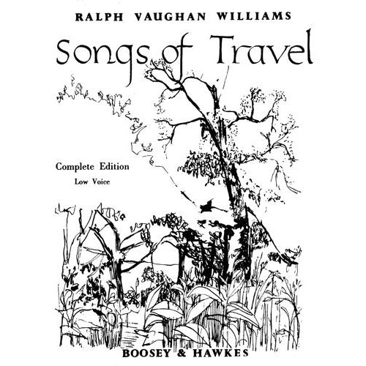

Slide 9
BEHAVOIR

Slide 10
Folk Music in Real Life
Folk music expresses the common culture of a people. It is the language shared by a whole people and is a part of daily life and practice.
(Nettl et al, 2012)

Slide 11
Activities that English Folk Music is Associated With
Banquets and Festivities
The repertoire of folk music contains many songs utilized as accompaniments to celebratory feasts, religious holidays or commonplace drinking shenanigans.
Work
Traditionally, the English used songs while doing repetitive tasks in order to coordinate themselves.
(Traditional English Folk Music, 2012)

Slide 12
SOUND

Slide 13
Style
Folk music originated as a divergence of traditional English court music
Folk music has diverse performance methods. Songs can be acappella or accompanied.
Many folk songs are polyphonic, or have multiple pitches performed at the same time.
A wide variety of instruments are utilized in the realm of English folk music.
(Folk music of England, 2012)
(Nettl et al, 2012)

Slide 14
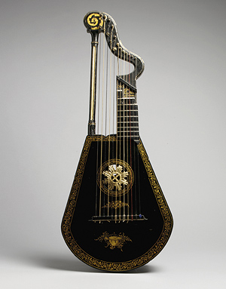
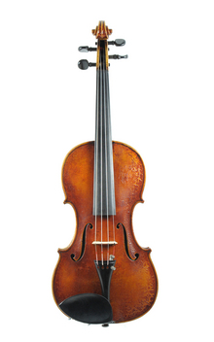
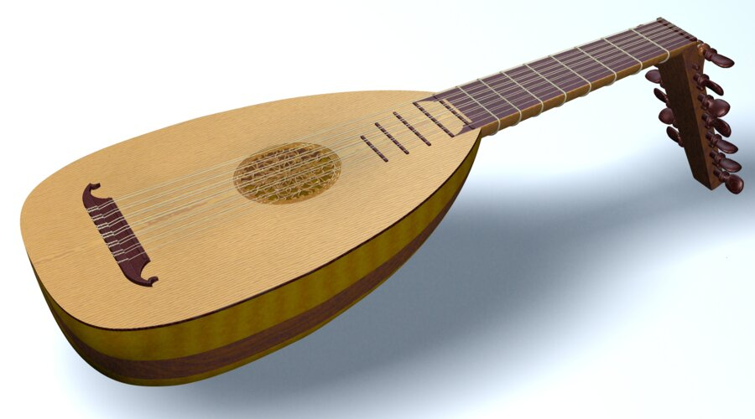
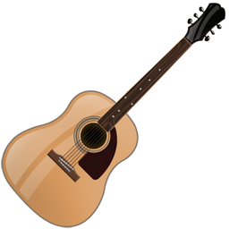
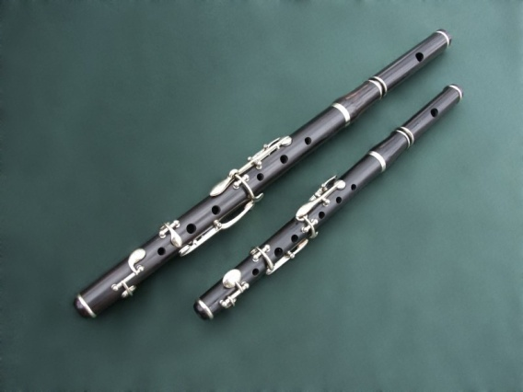
Instruments Modern and Traditional
Harp Lute
Violin
Lute
Guitar
Flute

Slide 15
Examples
Ballad – This is a traditional ballad preformed by a modern artist.
http://www.youtube.com/watch?v=hzo7fADr_50
Military Song – This is a song about a heroic British soldier who meets a lovely maiden.
http://www.youtube.com/watch?v=XR8Lf6qcSIo

Slide 16
English Folk vs. Middle Eastern Music
Differences:
Folk music can be used for entertainment, politics, military and has many other uses and is seen as an integral part of daily life.
Middle Eastern music is mostly used for religious purposes and music is seen a necessary but questionable part of this culture.
Measures have been taken to retain the traditionality of Middle Eastern Music while English Folk music has gone through several revivals in which it has bcome modernized, Americanized, etc.
English Folk music is a body of exactly recorded, Western style songs while Middle Eastern music is based upon a unique system of improvisation.
Similarities:
Both have been fairly influenced outside influences
Elements of both music styles have been incorporated into popular world music.
Both of these musical traditions have a distinct place in religious practices.

Slide 17
Image References
Guitar: http://www.iconarchive.com/show/stringed-instruments-icons-by-iconshock/Guitar-icon.html
Lute Harp:
http://www.halifaxscottish.com/woodwind-instruments_173-182_1.html
Lute:
http://www.corilon.com/shop/showItemVio.do?itemId=378&productId=3&lang=en
Satellite Photo:
http://www.electriccarsite.co.uk/
British Flag:
http://www.enchantedlearning.com/europe/britain/flag.shtml
Flute:
http://staffordrblcorpsofdrums.webs.com/bbflutes.htm
Song Book:
http://www.buy.com/th/bright-sheet-set.html
Violin:
http://store.drumbum.com/skuMGS-13.html

Slide 18
Works Cited
Wikipedia. (2012). Folk music of england. Retrieved from http://en.wikipedia.org/wiki/Folk_music_of_England
englandandenglishhistory.com. (2012). Traditional english folk music. Retrieved from http://www.englandandenglishhistory.com/traditional-english-folk-music
Nettl et al. (2012). Excursions in world music. (6 ed.). Boston : Pearson

