Slide 1


Parent and Family Orientation
Summer 2023
Kathy Kotecki
Dean of Student Engagement

Slide 2

ORIENTATION
AGENDA

Slide 3
ACADEMIC
SUCCESS

Slide 4
Classroom Expectations:
What do you think are some expectations your students will encounter in the classroom?

Slide 5
Classroom Environment & Structure Differences from High School
Size
Meeting times
Format – Lecture vs. discussion
Tests & Grading
Note taking
Student directed learning
Manage time, behavior, assignments and grades
Self-Advocate

Slide 6
Support for Academic Success
A&SC 111: First Year Seminar
Library
Student Support Services
Disability Support Services
Advising Center
Career and Employment Services
Academic Support Center

Slide 7
Course Scheduling Information
College Level
100 and above level courses
Courses go into GPA calculation and credits earned toward graduation
Developmental Education Courses
Below 100 level courses (M 088, M 098, WRIT 095)
Courses that “bridge the gap” between your current knowledge and the knowledge you need to be successful in your other courses
  Will not receive college credit for these courses and grade does not count toward GPA, but DOES count towards financial aid credit tracking
Enhanced Courses
Build in Study techniques to match curriculum as part of the Enhancement of the course; 5 days a week vs 3 to ensure additional support
  Examples:
    WRIT 101E, STAT 141E
***Course Placement Process
Advisors evaluate ACT/SAT scores, High School Transcripts and/or an Accuplacer math/writing assessment to place students into classes.

Slide 8
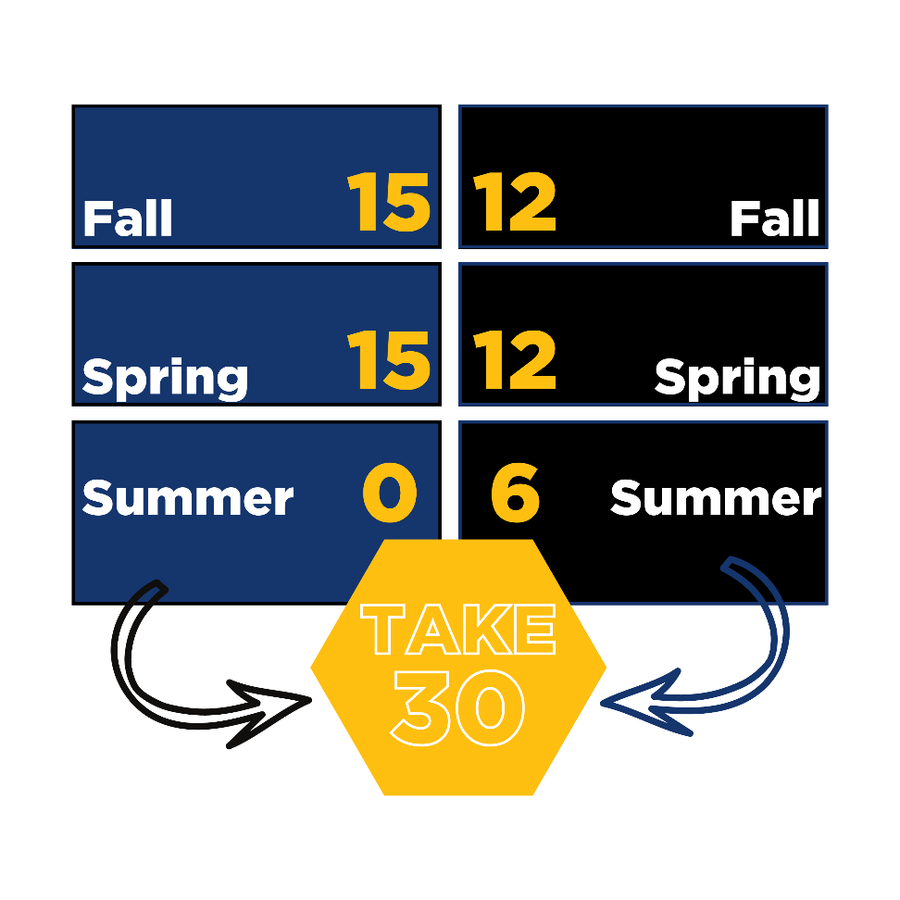
Take 30 Campaign
Students who take at least 30 credits per year are more likely to stay enrolled and graduate on time
The cost saving of even one less semester enrolled (Montana resident): over $3,000 (tuition and fees only!) AND puts students into the workforce earning an income sooner!

Slide 9
Summer Bridge Program
Enrolling in Summer Bridge prior to the start of Fall Semester can help set students up for a successful 30-credit year!
  College success skills and transition support
  English/Reading and Math skills development
  Become familiar with resources and services on campus
  Meet other students, faculty, and staff before Fall Semester even starts
  FREE for registered MSUB students!

Slide 10
Enhancing the Yellowjacket Experience

Slide 12
Housing & Residence Life
Housing Live-On Requirement
  Students less than 21 years of age with less than 30 credit hours accomplished before the start of the semester, are required to live in university owned residence halls.
Exemptions to the Requirement:
  Living with Family Member
  Attending Online
  Marriage
  Financial Hardship
  Medical

Slide 13
Housing & Residence Life
Academic Initiatives in the Residence Halls
  Living Learning Communities:
    Honors Program
    Health/Wellness Floor
    FYRE (First Year Residential Experience)
  Academic Advising
  Petro and Rimrock Classrooms
    Each residence hall has a designated classroom space with free computer and printing use.

Slide 14
Why is Involvement Outside the Classroom Important?
Connection to the University
Opportunity to build skills, connections
Peer Relationships
Scholarship/Resume Material
Academic Success
Enhance the collegiate experience
Career Exploration/Enhancement
Valuable when applying for competitive programs

Slide 15
Student Life
Student Events & Programming
Student Organizations
Civic Engagement
  Service Saturdays, Night on the Van
Athletics/Recreation
  NCAA Division, On-campus recreation center, intramurals
The Arts

Slide 16
Student Employment
Benefits
  Financial Assistance
  Skill Development
  Networking/Connections
Opportunities
  Work-Study
  Part-Time
  On Campus
  Off Campus

Slide 17
Important Campus Information

Slide 18
University Misconduct Process
Students are stewards and representatives of the university and held to Student Code of Conduct
MSUB will hold students accountable for misconduct, along with state, local, federal laws
  Education Vs. Enforcement
    MSUB is committed to the development of your student if they are committed to themselves
      Example: Alcohol Situation Resulting in Insight
Academic integrity is also the responsibility of the student
  Cheating, plagiarism, false citations, etc.

Slide 19
Clery Act
Enacted in 1990 after the death of Jeanne Clery (19) in 1986
  Assaulted and murdered by another student on campus after room was left unlocked
  Previous situations had not been reported to the campus in a timely manner
Requires all federally funded colleges to keep and disclose campus crime information
  Annual Campus Security Report due by Oct. 1
    Includes major crimes and fire situations
      Reports are kept for seven years and published emphatically

Slide 20
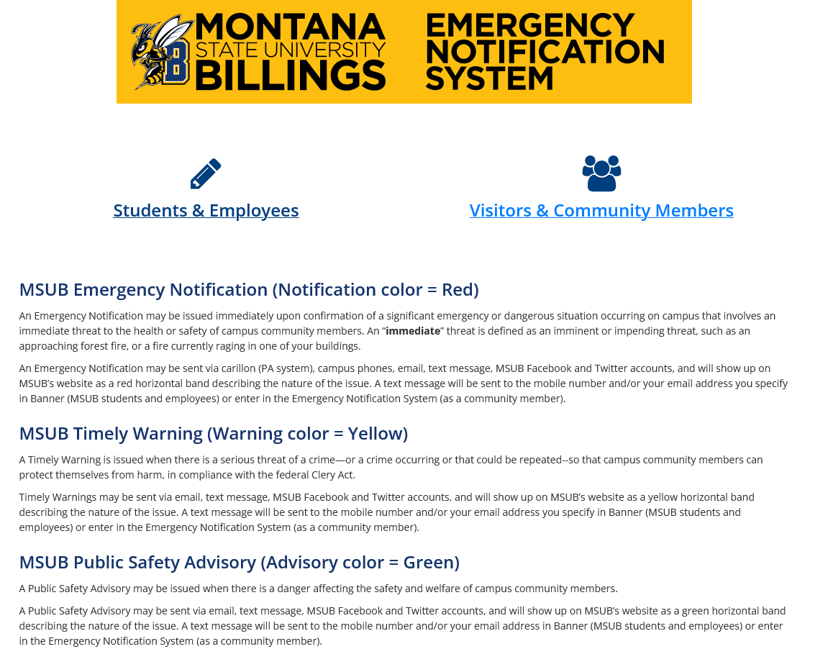

Slide 21
Important Health & Safety Information
Student Health Services
  Counseling Services
  Wellness
  Medical
  COVID-19 Testing
University Police
  24/7 POST certified University Police officers
Title IX

Slide 22
Online Mental Health Support Tools
ThrivingCampus is a HIPAA-compliant web-referral platform that connects students and employees to counseling services and community mental health and wellness providers.
Kognito provides interactive, evidence-based online mental health literacy and suicide prevention training to help students and employees identify students in distress and provide tools to respond or refer.
You@College is a secure and confidential platform that provides personalized health and wellness resources, including lifestyle surveys, career exploration tools and coping strategies, with a focus on well-being and suicide prevention.

Slide 23
Prevention Education
Student Health Services will contact students (new freshmen and new transfer students) in early August via e-mail with information on the programs, instructions, and deadline information. Students who do not complete the programs by the deadline will have a hold placed on their account which impacts their ability to register for the next semester.
2 Programs:
Alcohol Edu for College is an interactive, online program designed to inform students about how alcohol affects the mind, body, perceptions, and behaviors. It provides students with accurate, non-judgmental information and personalized feedback.
Sexual Assault Prevention for Undergraduates Or the Adult Learner is an interactive, online program created to address sexual assault, relationship violence, and stalking. It’s designed to engage and empower students to create safe, healthy campus environments.

Slide 24
FERPA & Parent Notification
Family Education Right to Privacy Act
  Affords student rights with respect to educational records, limiting anyone outside of the college to access
    Protects “educational records” including grades, transcripts, test scores, ID numbers, financial records, conduct records, and schedules
    Does allow for Directory Information including information that is not considered harmful and an invasion of privacy
    Legal constraints in place
    Supporting student development making transition to adulthood and providing rights and responsibilities
    Contacting Professors
    Grades

Slide 25
Parent & Family Programs
Newsletter
  Parents, guardians, and other family members of MSUB students are eligible for membership in the MSUB Family Connection newsletter. As a member, you will receive news and information of interest to parents and family members and invitations to special activities and events.
  Subscribe via the webpage today!
Webpage
  http://www.msubillings.edu/pfp/
Email Us
  pfp@msubillings.edu

Slide 26

QUESTIONS?

